Slide 1
Seeing Without Sight
What Blind Writers Can Teach Us About True Visualisation (And Science Agrees)
Notes:
This presentation was automatically generated by PowerPoint Copilot based on content found in this document: https://1drv.ms/w/c/f76ae15bbc4cfc1d/EfMOu90KVMpLmDO0YvZwwFsBa75Iev9jzAljHL7BTn56BQ?e=xdmqT2 AI-generated content may be incorrect.

Slide 2
Agenda
Introduction
The Mind's Eye
Sensory Substitution
Case Studies and Examples
Proof from Legends
Multimodal Sensory Processing
The Blind Advantage
Practical Applications
Conclusion
Notes:
Agenda * Introduction * Visualisation and Ancient Wisdom * Impact on Creativity and Problem-Solving * The Mind's Eye * Concept of the Third Eye * Spatial Reasoning in Blind Individuals * Disclaimer on Meditation * Sensory Substitution * Science of Sensory Substitution * Multimodal Approaches * Application in Creative Work * Case Studies and Examples * The Ferrari Story * Cognitive Mapping in Blind Individuals * Blind Detectives * Proof from Legends * Helen Keller and John Milton * Modern Neuroscience Confirmation * Multimodal Sensory Processing * Creating Sensory Architecture * Engaging Multiple Cognitive Channels * The Blind Advantage * Neuroscience Insights * Reverse-Engineering Cognitive Superpower * Practical Applications * For Writers * For Creative Professionals * For Problem Solvers * For Everyone * Conclusion * Ancient Wisdom and Modern Science * Final Takeaway

Slide 3
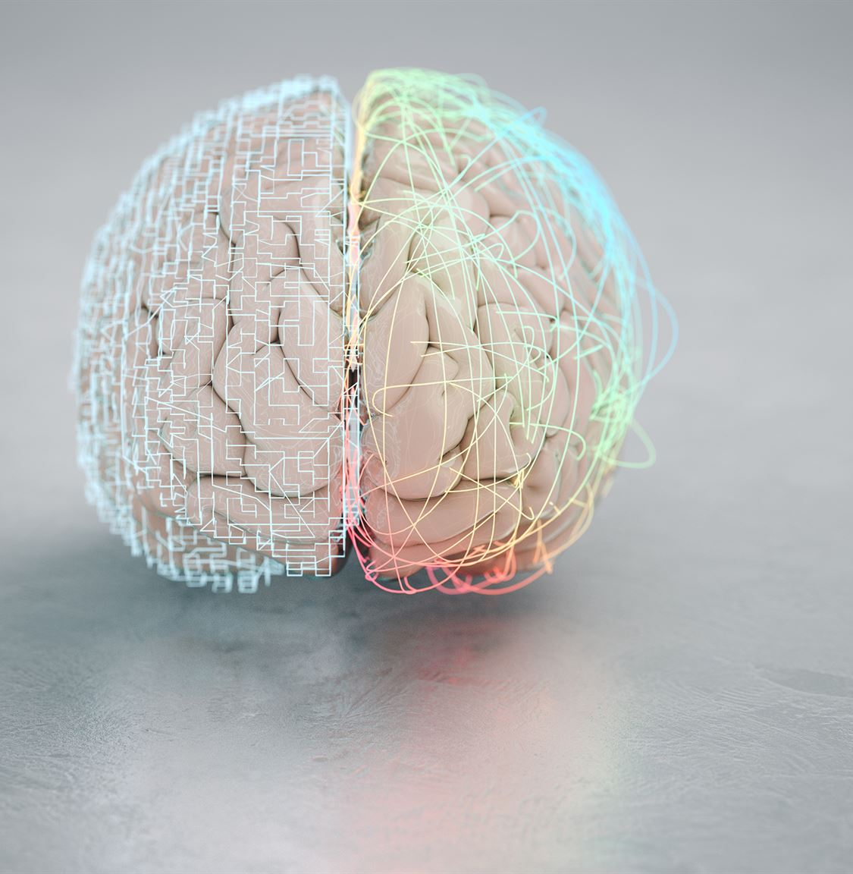
Visualisation and Ancient Wisdom
Lord Shiva's Third Eye
Symbolizes seeing beyond the ordinary
Common in traditional Hindu homes
Modern Science and Ancient Wisdom
Recent research aligns with ancient beliefs
Blind people can 'visualise' without eyesight
Neuroscience Insights
Visualisation without eyesight is scientifically proven
Not mystical, but based on neuroscience
Notes:
Imagine sitting in a pooja room, gazing at Lord Shiva's third eye. This ancient symbol of seeing beyond the ordinary is now supported by modern neuroscience. Recent studies show that blind people can 'visualise' without eyesight, proving ancient wisdom right. Original Content: Picture this: you are sitting in a pooja room, staring at Lord Shiva's third eye blazing from his forehead like a cosmic torchlight. If you are Indian (or have even visited a traditional Hindu home), you know exactly what I am talking about. That mysterious third eye is not just ornamental—it is a masterclass in seeing what the ordinary eye misses. Now, before you smirk and think I am about to hand you crystals and rudraksha beads, here's the interesting part: modern science is finally catching up with ancient wisdom. Recent research shows that blind people can genuinely 'visualise' without eyesight—and no, it is not some airy-fairy business, it is pure neuroscience.

Slide 4
Impact on Creativity and Problem-Solving
Impact on Creativity
Blind individuals use unique methods to visualize concepts
Can inspire new approaches to creative thinking
Enhancing Problem-Solving Skills
Blind people develop alternative strategies to solve problems
These strategies can be adapted to improve general problem-solving
Influence on Writing Techniques
Writing can be enriched by understanding blind people's perspectives
Leads to more inclusive and diverse content creation
Notes:
Understanding how blind people 'see' can revolutionize creativity, problem-solving, and writing. Their unique visualization methods inspire new creative approaches. Alternative problem-solving strategies developed by blind individuals can enhance general problem-solving skills. Writing techniques can be enriched by their perspectives, leading to more inclusive content. Original Content: But the real game-changer? Understanding how blind people "see" could completely change how you tackle creativity, problem-solving, and writing.

Slide 5
Concept of the Third Eye
Concept of the 'third eye'
Known as Agnya Chakra in many cultures
Treated seriously in traditions
Studies on visualisation
Fundamentally about spatial reasoning
Not limited to physical sight
Blind people's visualisation
Using same cognitive tools as sighted people
Different pathways for visualisation
Notes:
The concept of the 'third eye,' known as Agnya Chakra, is taken seriously in many traditions. Studies show visualisation is about spatial reasoning, not just physical sight. Blind people use the same cognitive tools as sighted individuals, but through different pathways. Original Content: The Mind's Eye Is Not a Metaphor The idea of a "third eye"—what our elders would call the Agnya Chakra—exists in many cultures, but our traditions have always treated it seriously. And here's what might surprise you: studies show that visualisation is fundamentally about spatial reasoning, not just what you see with your physical eyes. When blind people "visualise," they are not pretending—they are using the same cognitive tools sighted people do, but through different pathways.

Slide 6
Spatial Reasoning in Blind Individuals
Brain Functionality Beyond Vision
Vision is just one aspect of brain function
Other senses and cognitive tools are equally powerful
Utilizing All Cognitive Tools
Importance of using all cognitive abilities
Not relying solely on familiar senses
Spatial Understanding in Blind Individuals
Blind individuals navigate complex data through touch and sound
Accuracy comparable to sighted individuals using vision
Cognitive Excellence
Not merely compensation for lack of vision
Represents advanced cognitive abilities
Notes:
Our brain functions like a smartphone with multiple apps. Vision is just one of these apps. Recent research shows that blind individuals can navigate complex data visualizations through touch and sound with the same accuracy as sighted people using their eyes. This isn't compensation, but cognitive excellence. Original Content: Think of your brain like a smartphone. Vision is just one app. Uninstall it, and you still have a powerful device with other tools to process the world. The real question is—are you using all your apps, or sticking only to the familiar one? Recent research reveals that this spatial understanding is so sophisticated that blind individuals can navigate complex data visualisations through touch and sound with the same accuracy as sighted people using their eyes. It's not compensation—it's cognitive excellence.

Slide 7

Disclaimer on Meditation
Importance of Proper Guidance
Attempting meditation without guidance is risky
Proper guidance is essential for safe practice
Comparison to Brain Surgery
Trying brain surgery after watching Instagram reels is possible
However, it is not sensible
Notes:
It is crucial to have proper guidance when meditating and raising your Kundalini. Attempting this without guidance is as risky as trying brain surgery after watching Instagram reels. It may be possible, but it is not sensible. Original Content: Disclaimer: I am not asking you to start meditating and raising your Kundalini without proper guidance. That is like trying brain surgery after watching a couple of Instagram reels. Possible, yes. Sensible? Not at all.

Slide 8
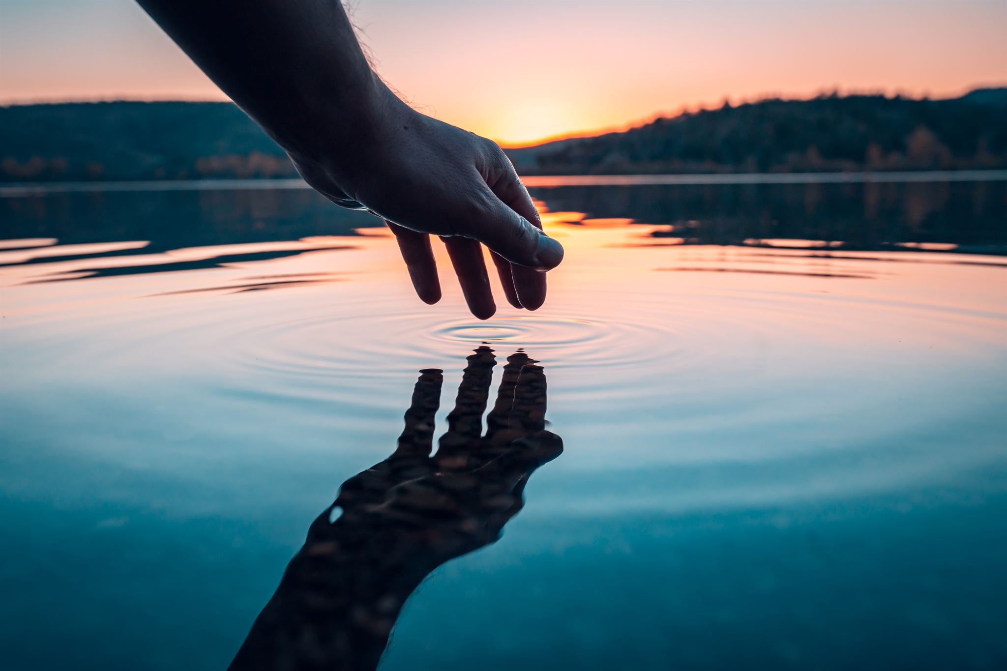
Science of Sensory Substitution
Sensory Substitution
Brain's ability to convert one type of sensory input into another
Comparable to Google Translate for senses
Touch Becomes Sight
Scientists' discovery of sensory substitution
Remarkable adaptability of the brain
Notes:
Scientists have discovered sensory substitution, where the brain can convert one type of sensory input into another. This fascinating ability is like a built-in Google Translate for our senses, showcasing the brain's remarkable adaptability. Original Content: Here is where it gets fascinating for everyone, sighted or blind. Scientists have uncovered something called "sensory substitution"—the brain's remarkable ability to convert one type of sensory input into another. Think of it as a built-in Google Translate for your senses. When Touch Becomes Sight: The Science of Sensory Magic

Slide 9
Multimodal Approaches
Blind individuals' methods for reading graphs
Touching raised diagrams
Hearing patterns through audio cues
Benefits of mixed-sense approaches
Reduced cognitive workload
More efficient use of senses
Development of tools for sighted people
Experiencing information through sound, touch, and spatial reasoning
Enhanced understanding and retention
Notes:
Blind individuals use touch and audio cues to read graphs, reducing cognitive workload. Researchers are developing tools for sighted people to experience information through sound, touch, and spatial reasoning, enhancing understanding and retention. Original Content: Blind individuals can "read" graphs by touching raised diagrams or "hear" patterns in data through specially designed audio cues. One study even found these mixed-sense approaches actually reduce cognitive workload compared to traditional speech-only interfaces. In short, cutting off one sense often makes the others work more efficiently, not just harder. But here's the kicker: researchers are now developing tools that let sighted people experience information the way blind people naturally do—through combinations of sound, touch, and spatial reasoning. Early results suggest this multimodal approach can enhance understanding and retention for everyone.

Slide 10
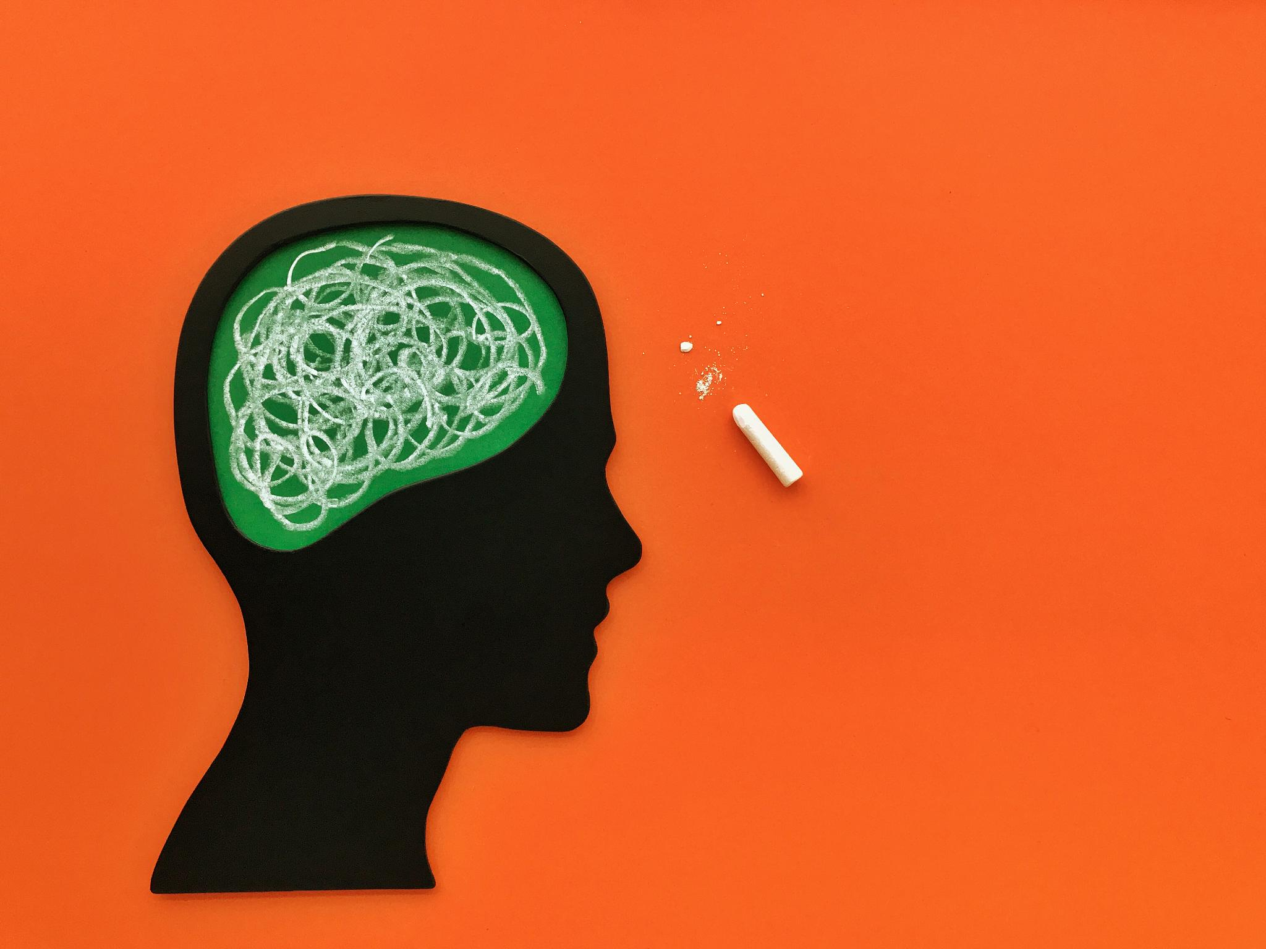
Application in Creative Work
Story's Rhythm
Feel the flow and pace of your narrative
Emotional Texture
Hear the emotional undertones and nuances
Structural Architecture
Sense the framework and organization of your story
Neuroscience Backing
Scientific basis for enhancing storytelling
Notes:
Imagine feeling the rhythm, hearing the emotional texture, and sensing the structural architecture of your story. This poetic idea is supported by neuroscience, enhancing storytelling. Original Content: Now imagine using this in your own work. What if you could feel your story's rhythm, hear its emotional texture, and sense its structural architecture, instead of only seeing it in your head? Sounds poetic, but it is backed by solid neuroscience.

Slide 11
The Ferrari Story
Motivational Speaker's Story
Skip Ross shared a story about a businessman and his Ferrari poster
Businessman believed he would own the exact Ferrari from the poster
Eventually, he did own that specific Ferrari
Science Behind Visualization
Blind people create mental models using sensory integration
They infer colours, shapes, and spatial layouts through logical reasoning
Recent PNAS study supports this phenomenon
Notes:
Skip Ross shared a story about a businessman who visualized owning a Ferrari and eventually did. Science supports visualization, showing that blind people infer details through sensory integration and logical reasoning, as evidenced by a recent PNAS study. Original Content: The Ferrari Story (And Why It Is Not Just a Gimmick) Many years ago, motivational speaker Skip Ross told a story about a businessman who kept a poster of a red Ferrari in his office. He looked at it daily, convinced he would one day own it. Plot twist: not just any Ferrari—the exact one from the poster landed in his garage. Now, I can already hear some of you grumbling, "Old trick, no?" But science says otherwise. Blind people constantly build mental models of things they cannot see using sounds, textures, environmental cues, and cultural knowledge. A recent PNAS study showed that they infer colours, shapes, and spatial layouts through logical reasoning and sensory integration—not just memorisation.

Slide 12
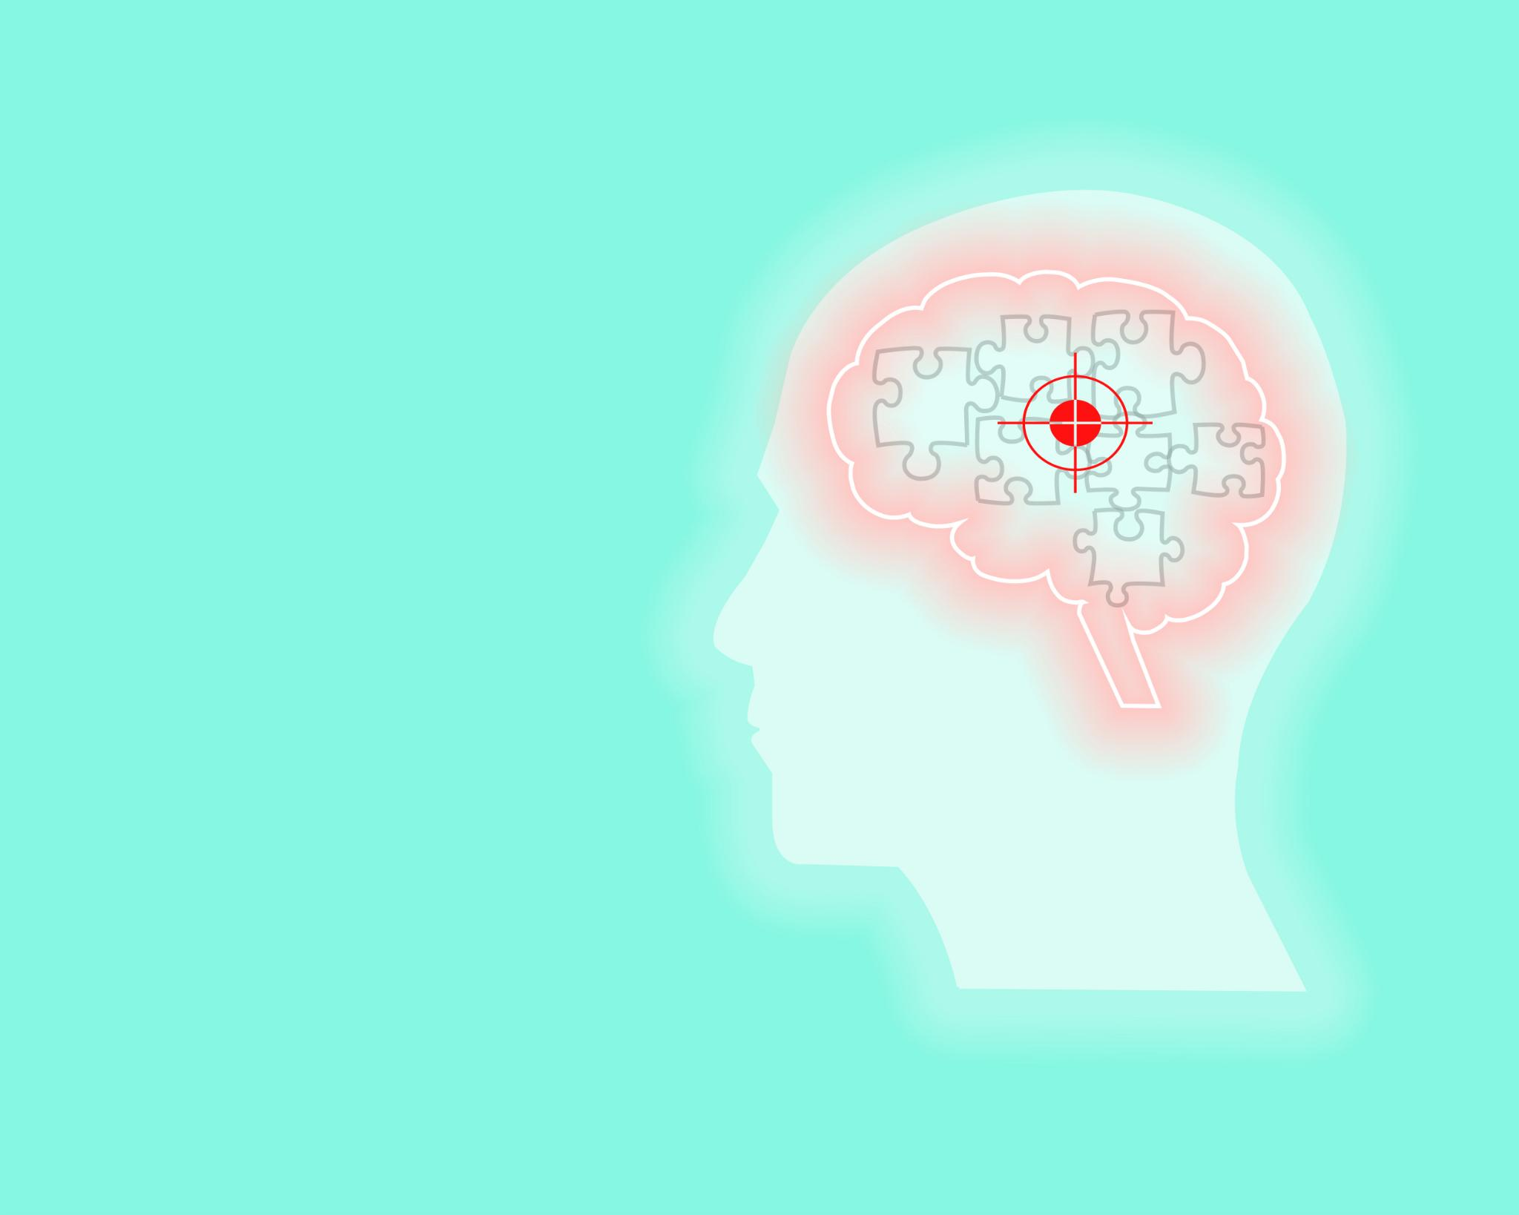
Cognitive Mapping in Blind Individuals
Blind people use cognitive mapping
Build complete pictures from fragments of non-visual information
Spatial inference
Understanding surroundings without visual cues
Potential benefits for people with perfect eyesight
Could enhance perception and understanding
Notes:
Blind individuals use cognitive mapping and spatial inference to build complete pictures from non-visual information. This approach could also benefit those with perfect eyesight by enhancing their perception and understanding. Original Content: In other words, what that businessman did with a poster, blind people do daily—without needing a poster. They engage what researchers call "cognitive mapping" and "spatial inference," building complete pictures from fragments of non-visual information. The question for the rest of us: could we benefit from this approach even with perfect eyesight?

Slide 13

Blind Detectives
Blind people as master detectives
Operate at Sherlock Holmes level
Elite-level cognitive mapping skills
Identifying locations through sound
Door creaks indicate specific rooms
Floor texture changes signal different areas
Using air movement to detect presence
Air movement indicates someone entering the room
Notes:
Blind individuals possess elite cognitive mapping skills, akin to master detectives like Sherlock Holmes. They identify locations through distinct sounds, changes in floor texture, and air movement, showcasing abilities that most sighted people never develop. Original Content: Blind Detectives of Everyday Life: Masters of Cognitive Mapping Blind people are like master detectives operating at Sherlock Holmes level. A door creaks differently, and they know it is the kitchen. A change in floor texture tells them they have reached the balcony. The way air moves indicates someone just entered the room. It is not about compensation—it is elite-level cognitive mapping that most sighted people never develop.

Slide 14
Helen Keller and John Milton
Imagination without Eyesight
Helen Keller and John Milton as case studies
Helen Keller's The Story of My Life
Vivid scenes used in spatial cognition research
Superior sensory integration
John Milton's Paradise Lost
Evocative passages written after blindness
Advanced spatial visualisation techniques
Imagination through spatial reasoning
Rich, detailed environments
Sophisticated neural pathways
Notes:
Helen Keller and John Milton are prime examples of imagination without eyesight. Keller's vivid scenes in The Story of My Life are used in spatial cognition research, showcasing superior sensory integration. Milton's evocative passages in Paradise Lost, written after blindness, demonstrate advanced spatial visualisation techniques. Their imagination thrived through spatial reasoning and sophisticated neural pathways. Original Content: Proof from the Legends: When Blindness Sharpens Vision Want solid proof that imagination does not need eyesight? Two names that science now uses as case studies: Helen Keller and John Milton. Keller's The Story of My Life paints scenes so vividly that researchers studying spatial cognition use her descriptions as examples of superior sensory integration. Most sighted writers would be left humbled by her ability to construct rich, detailed environments through pure spatial reasoning. Milton wrote Paradise Lost's most evocative passages after going blind, using what scientists now recognise as advanced spatial visualisation techniques. His imagination did not dim—it just found more sophisticated neural pathways to express itself.

Slide 15
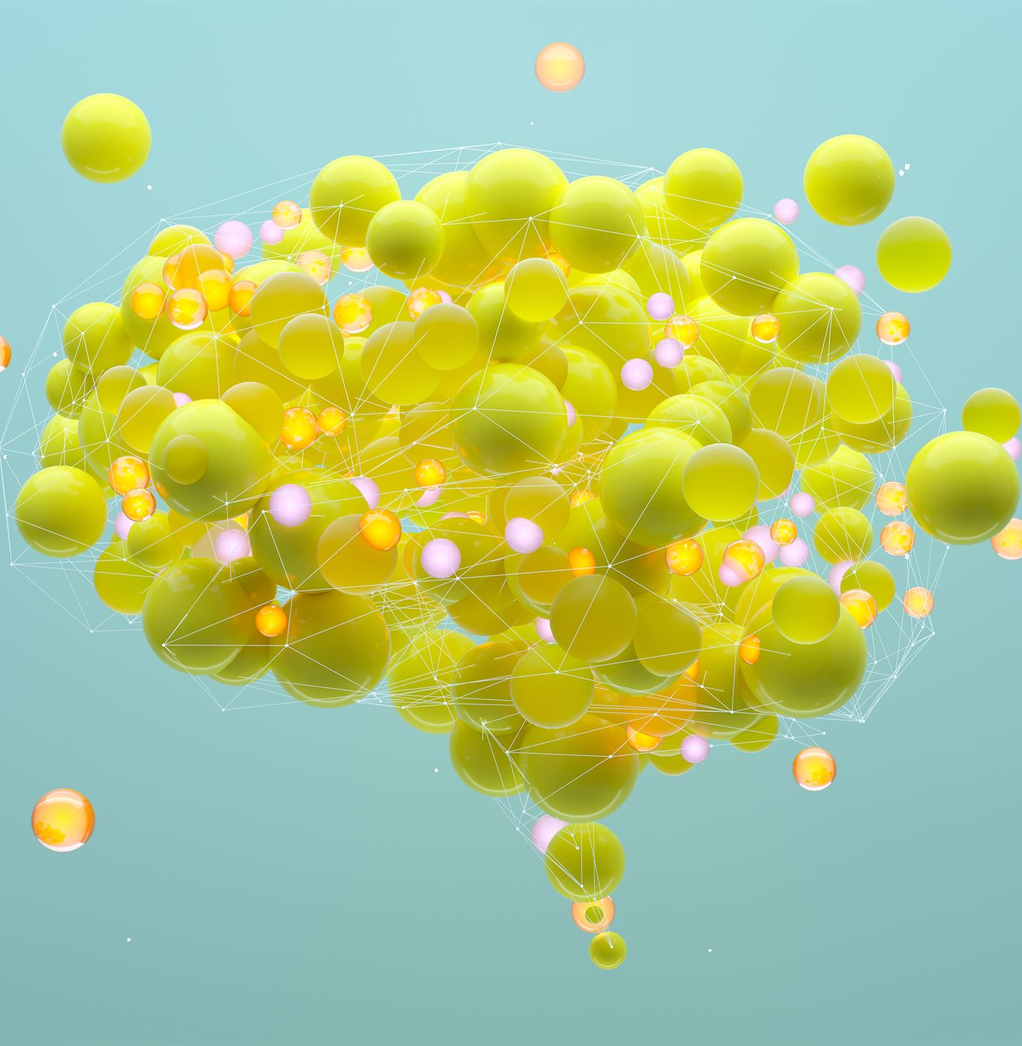
Modern Neuroscience Confirmation
Modern neuroscience findings
Confirming ancient seers' knowledge
Literary greats' understanding
True visualisation
Involves spatial processing
Involves cognitive processing
The third eye concept
Not about physical vision
About perception beyond sensory limitations
Notes:
Modern neuroscience confirms that true visualisation involves spatial and cognitive processing, not eyesight. Ancient seers and literary greats understood this concept. The third eye represents perception beyond sensory limitations. Original Content: Modern neuroscience is finally confirming what our ancient seers and these literary greats knew centuries ago: true visualisation is about spatial and cognitive processing, not eyesight. The third eye was never about physical vision—it was about perception that transcends sensory limitations.

Slide 16
Creating Sensory Architecture
Multimodal Sensory Processing in Writing
Engages multiple cognitive channels simultaneously
Creates experiences rather than mere descriptions
Blind Writers' Unique Approach
Reconstruct scenes through spatial positioning
Utilize auditory mapping for footstep patterns
Employ tactile awareness for air pressure changes
Incorporate emotional geography for expanding silence
Impact of Sensory Architecture
Results in vivid and emotionally resonant descriptions
Often feels more complete than purely visual accounts
Notes:
True writing transforms readers by engaging multiple cognitive channels simultaneously. Blind writers naturally create experiences through spatial positioning, auditory mapping, tactile awareness, and emotional geography. This results in vivid and emotionally resonant descriptions, often more complete than purely visual accounts. Original Content: From Dry Prose to Rich, Sensory Architecture Anyone can string sentences together grammatically. But true writing—writing that transforms readers—requires what researchers call "multimodal sensory processing." What blind writers do naturally is engage multiple cognitive channels simultaneously to create experiences rather than mere descriptions. When a blind writer describes a father walking away without acknowledging his child's achievement, they are not drawing from visual memory. They are reconstructing the scene through spatial positioning (where he stood relative to the child), auditory mapping (footstep patterns and fading), tactile awareness (air pressure changes), and emotional geography (the expanding silence). The result is not just a description—it is a complete sensory architecture that often feels more vivid and emotionally resonant than purely visual accounts.

Slide 17

Engaging Multiple Cognitive Channels
Utilizing Cognitive Channels
Importance of engaging all senses
Potential depths to discover
Defaulting to Visual
Common tendency in creation
Limitations of relying solely on visual
Deliberate Engagement
Actively using other senses
Enhancing creative process
Notes:
Are you using all your cognitive channels when you create, or just defaulting to the visual? Consider the depths you might discover if you deliberately engaged your other senses. Original Content: So here is a question worth asking: Are you using all your cognitive channels when you create, or just defaulting to the visual? What depths might you discover if you deliberately engaged your other senses?

Slide 18
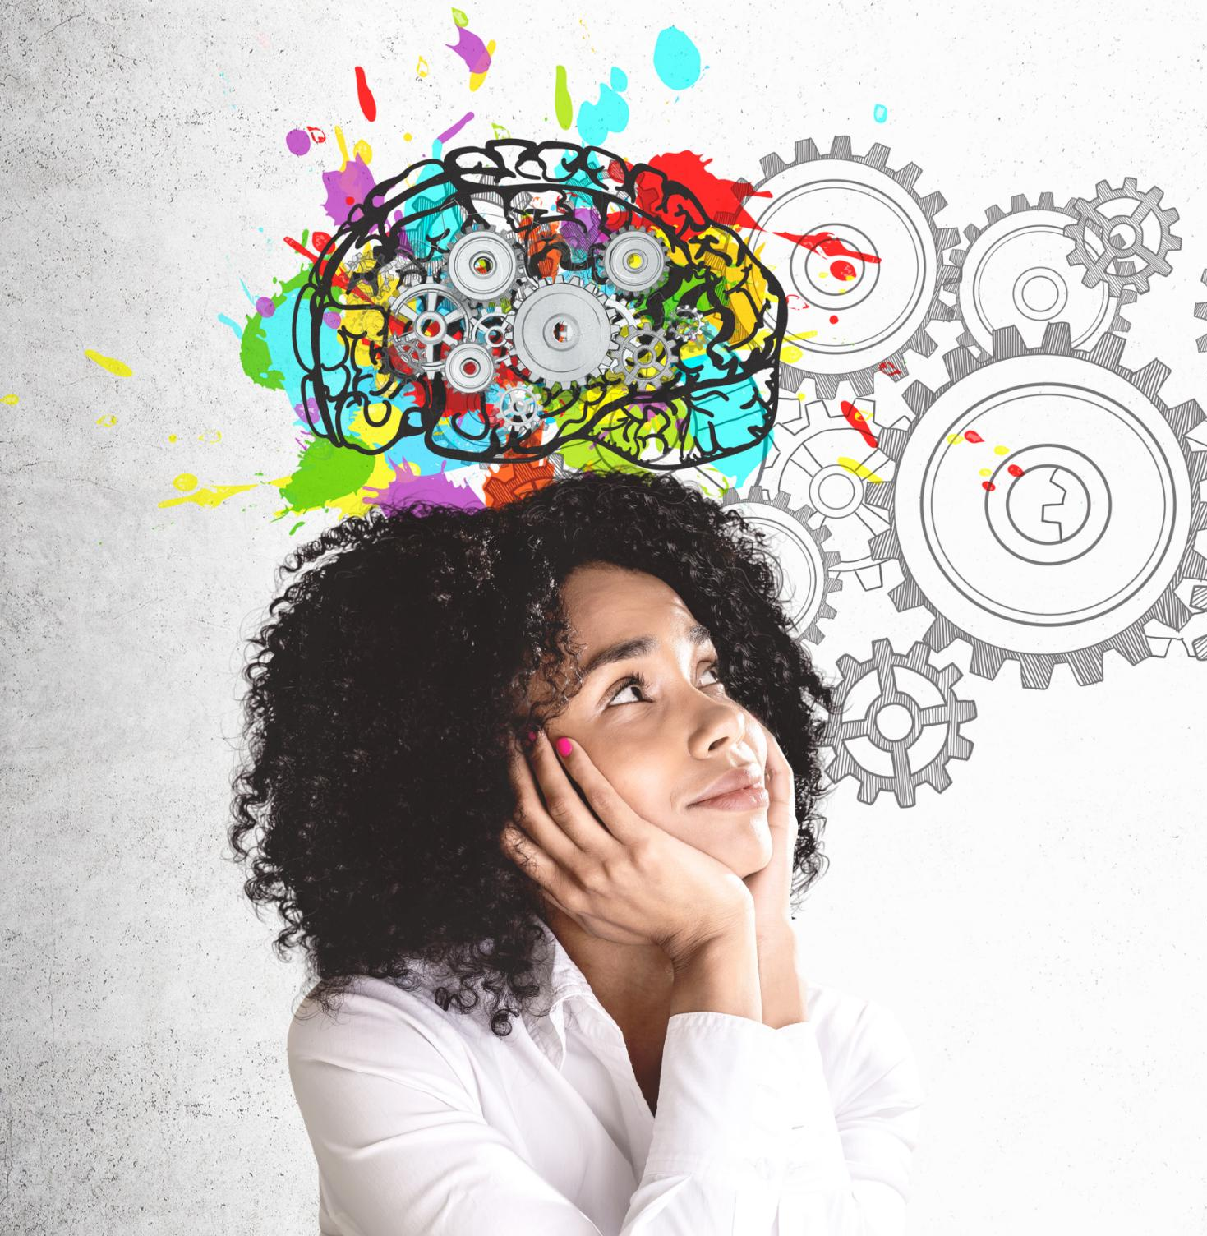
Neuroscience Insights
Visual Acuity in Sighted People
Develop visual memory stored in one part of the brain
Multisensory Processing in Blind People
Coordinate spatial reasoning
Utilize auditory processing
Engage tactile memory
Employ cognitive inference across multiple neural networks
Comparison of Cognitive Abilities
Sighted people rely on visual memory
Blind people run several high-performance apps simultaneously
Notes:
Research shows that while sighted people develop visual acuity, blind people often develop the ability to process complex information through multiple sensory channels simultaneously. Blind individuals coordinate spatial reasoning, auditory processing, tactile memory, and cognitive inference across multiple neural networks, unlike sighted individuals who rely mainly on visual memory. Original Content: The Blind Advantage: What Neuroscience Reveals Here's the delicious irony that research has uncovered: while sighted people develop visual acuity, blind people often develop something potentially more powerful—the ability to process complex information through multiple sensory channels simultaneously. When a sighted person says, "I can see it," they are typically accessing visual memory stored in one part of the brain. When a blind person says, "I can imagine it," they are actively coordinating spatial reasoning, auditory processing, tactile memory, and cognitive inference across multiple neural networks. It is like running several high-performance apps simultaneously while others rely on just one.

Slide 19
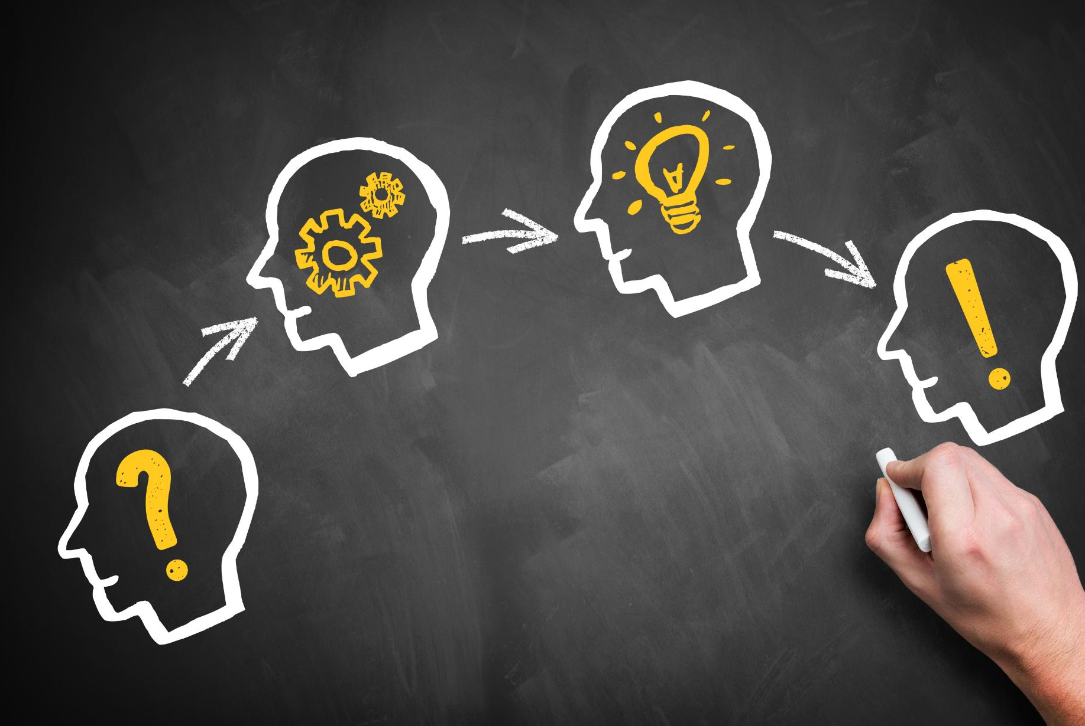
Reverse-Engineering Cognitive Superpower
Reverse-engineering cognitive superpower
Developing tools for sighted people
Experiencing data like blind people
Applications in various fields
Storytelling
Marketing
Product design
Creative problem-solving
Engaging multiple cognitive channels
Presentations with integrated sound and touch
Stories creating spatial experiences
Brainstorming sessions limiting visual input
Notes:
Current research aims to reverse-engineer cognitive abilities by developing tools for sighted people to process data like blind individuals. Applications include storytelling, marketing, product design, and creative problem-solving, engaging multiple cognitive channels through sound, touch, spatial reasoning, and logical inference. Original Content: Current research projects are literally trying to reverse-engineer this cognitive superpower. Scientists are developing tools that help sighted people experience data and information the way blind people naturally process it—through integrated sound, touch, spatial reasoning, and logical inference. The applications for storytelling, marketing, product design, and creative problem-solving are enormous. Imagine presentations that engage multiple cognitive channels, stories that create spatial experiences, or brainstorming sessions that deliberately limit visual input to force deeper neural engagement.

Slide 20
For Writers
For Writers
Close your eyes while crafting scenes
Describe scenes using temperature, air movement, sound layers, and texture
Language becomes more precise and details more specific
Creates stronger emotional connections with readers
For Marketers
Craft campaigns that stick in memory
Use multimodal approaches to enhance engagement
General Creative Challenges
Apply techniques of blind visualisation immediately
Approach creative tasks with new perspectives
Notes:
Blind visualisation offers practical techniques for various creative fields. Writers can enhance their descriptions by closing their eyes and focusing on sensory details. Marketers can craft memorable campaigns using multimodal approaches. These techniques can be applied immediately to tackle creative challenges with fresh perspectives. Original Content: What This Means for You: Practical Applications Whether you are a writer struggling to make your descriptions come alive, a marketer trying to craft campaigns that stick in memory, or just someone seeking new ways to approach creative challenges—the science of blind visualisation offers concrete techniques you can apply immediately. For Writers: Try this experiment. Close your eyes while crafting your next scene. Describe it through temperature, air movement, sound layers, and texture. Notice how your language becomes more precise, your details more specific. Research shows this multimodal approach creates stronger emotional connections with readers.

Slide 21

For Creative Professionals
Engage Multiple Senses
Build presentations like music or physical spaces
Create a felt experience, not just words and images
Enhanced Memory Retention
Studies suggest multimodal presentations are remembered longer
Greater accuracy in recalling information
Creative Approach
Design presentations to engage various senses
Incorporate elements that evoke emotions and experiences
Notes:
Creative professionals should design presentations like music or physical spaces, engaging multiple senses. Studies show multimodal presentations enhance memory retention and accuracy. Incorporate elements that evoke emotions and experiences for a lasting impact. Original Content: For Creative Professionals: Build your next presentation like a piece of music or a physical space you can walk through. Not just words and images, but a felt experience that engages multiple senses. Studies suggest multimodal presentations are remembered longer and with greater accuracy.

Slide 22

For Problem Solvers
Creative Wall Solutions
Switch off your dominant sense
Visual thinkers should try hearing solutions
Cognitive Flexibility
Leads to breakthrough insights
Pure visual thinking may miss these insights
Notes:
When facing a creative block, switch off your dominant sense. Visual thinkers should try hearing solutions. This cognitive flexibility can lead to breakthrough insights that visual thinking may miss. Original Content: For Problem Solvers: When you hit a creative wall, deliberately switch off your dominant sense. If you usually visualise solutions, try "hearing" them instead—what would this problem sound like if it were music? This cognitive flexibility often leads to breakthrough insights that pure visual thinking misses.

Slide 23
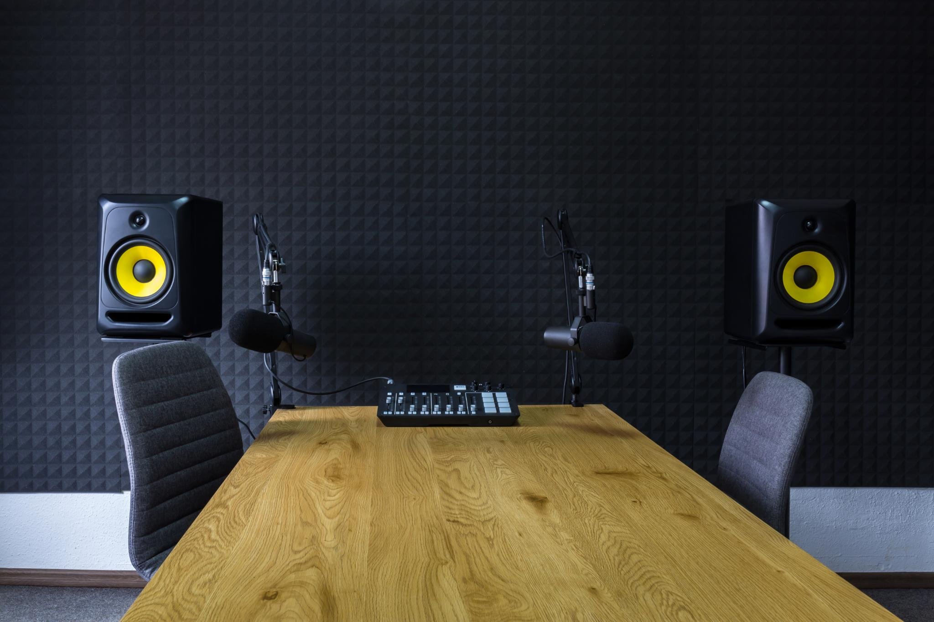
For Everyone
Distinct Acoustic Signatures of Rooms
Each room has a unique sound profile
Notice variations in echoes and sound absorption
Surface Sensations Underfoot
Different textures and materials
Impact on movement and comfort
Air Movement in Spaces
Changes when someone enters
Influence on temperature and airflow
Enhanced Sensory Vocabulary
Improves cognitive processes
Enriches perception and understanding
Notes:
Developing environmental spatial awareness involves noticing the unique acoustic signatures of rooms, the sensations of surfaces underfoot, and the shifts in air when someone enters a space. This enhanced sensory vocabulary enriches cognitive processes. Original Content: For Everyone: Start developing what researchers call "environmental spatial awareness." Notice how different rooms have distinct acoustic signatures, how surfaces feel underfoot, how air shifts when someone enters a space. This enhanced sensory vocabulary will enrich all your cognitive processes.

Slide 24
Ancient Wisdom and Modern Science
Third Eye Concept
Not just religious symbolism
Neurological reality backed by research
Hindu Philosophy
True sight is cognitive perception
Not limited to physical eyes
Blind Professionals
Analyse complex datasets
Navigate spatial challenges
Solve creative problems
Enhanced Cognitive Strategies
Neuroscience Findings
Notes:
Ancient wisdom and modern science converge in the concept of the third eye. Hindu philosophy's idea of true sight is now backed by neuroscience, showing cognitive perception beyond physical eyes. Blind professionals excel in complex tasks due to enhanced cognitive strategies, proving superior approaches. Recent studies validate the third eye's prescient vision, using spatial reasoning and sensory integration. Original Content: The Takeaway: Where Ancient Wisdom Meets Cutting-Edge Science Your "third eye" is not just religious symbolism—it is neurological reality backed by peer-reviewed research. Science now validates what Hindu philosophy grasped millennia ago: true sight is not about seeing more with your physical eyes, but perceiving differently with your entire cognitive apparatus. Modern studies demonstrate that blind professionals can analyse complex datasets, navigate spatial challenges, and solve creative problems as effectively as sighted individuals—not despite their blindness, but often because of the enhanced cognitive strategies they develop. These are not inferior workarounds—research increasingly shows they are often superior approaches. Recent neuroscience reveals that the third eye concept was remarkably prescient: there really is a form of "vision" that operates independently of physical sight, using spatial reasoning, sensory integration, and cognitive mapping to construct complete understanding of reality.

Slide 25
Final Takeaway
Creative Wall Solutions
Ancient wisdom and modern science agree on the effectiveness of closing your eyes
Not about looking harder, but perceiving deeper
The Third Eye Concept
Not just mystical visions, but cognitive vision
Transcends sensory limitations
Transformative Skill
Mastering cognitive vision can change how you think, create, and engage
Profound Insights
Ancestors knew and science proves insights come from understanding
Notes:
When facing a creative block, remember that closing your eyes can help you perceive deeper. The third eye represents cognitive vision beyond sensory limits. Mastering this skill can transform your thinking and creativity. Profound insights come from understanding, as both ancient wisdom and modern science confirm. Original Content: So the next time you hit a creative wall or find yourself stuck on a problem, remember what both ancient wisdom and modern science confirm: sometimes, closing your eyes is the most effective way to truly see. Not looking harder, but perceiving deeper. The third eye was never about mystical visions alone—it was about cognitive vision that transcends sensory limitations. And mastering this skill could completely transform how you think, create, and engage with your world. After all, as our ancestors knew and science now proves: the most profound insights often come not from what we see, but from what we understand.

